Slide 1
Lecture 11: Conversion of Regular Expression to Regular Language and NFA-ε to DFA
Agenda
RE- RL and Vice Versa with examples
RE-NFA-ε to DFA with examples
Presented by
Prof. Vaibhav Narayan Chunekar
K. J. Somaiya College of Engineering, Vidyavihar, Mumbai

Slide 2
Construction of Regular Language by using Regular Expression
Example 1 : Describe in simple English the language represented by regular expression r=(1+10)*
Solution: Let us try all strings in the language possible by describing r
L(r)={ε,1,10,110,101,110,1010,…...……………..}
L (r) = { w ∈ {0,1}| w consist of infinite language with 0’s and 1’s| w begin with 1 and does not contain any 2 consecutive zeroes.}
Example 2 : Describe in simple English the language represented by regular expression r=(0+01)* ?
➔

Slide 3
Construction of Regular Expression by Regular Language
Example 1: L (r) = { w ∈ {0,1}*| w containing all possible combinations of 0’s and 1’s| w begin with either 1 or 0 and does not contain any 2 consecutive zeroes.}
Solution➔
r1=(1+10)*
r2=0.(1+10)*
r3= r1+r2
r3=(1+10)* + (0(1+10)*)➔(1+10)*(ε+0)

Slide 4
Construction of Regular Expression by Regular Language
Example 2: L (r) = { w ∈ {a,b}*| w containing all possible combinations of 0’s and 1’s| w containing at least one a and one b}
Solution➔
r1=(a+b)*. a. (a+b)*.b.(a+b)*
r2=(a+b)*. b. (a+b)*.a.(a+b)*
r3= r1+r2
r3=(a+b)*. a. (a+b)*.b.(a+b)* + (a+b)*. b. (a+b)*.a.(a+b)*

Slide 5
Conversion Regular Expression to DFA

Slide 6
Convert RE to DFA – Example 1
Regular Expression: r= (0+01)*
Step1 : Convert RE to NFA-ε
Step2 : Find ε-Closure with NFA-ε
Step3 : State Transition Table.
Step4 : Minimized DFA.

Slide 7
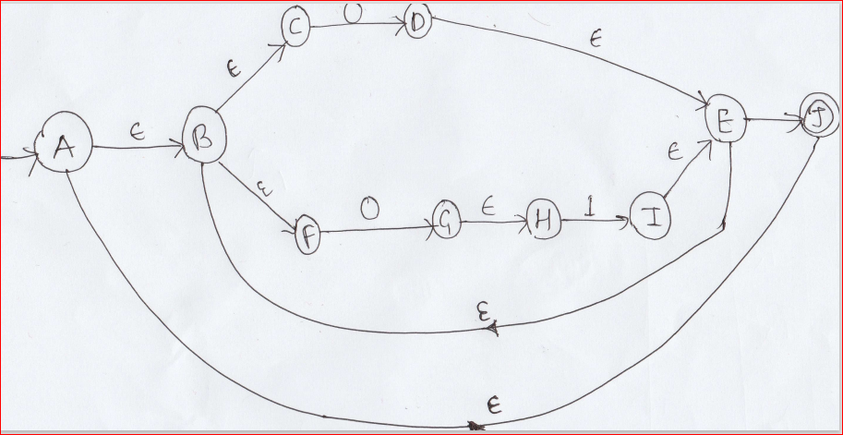
Step1 : Convert RE to NFA-ε

Slide 8
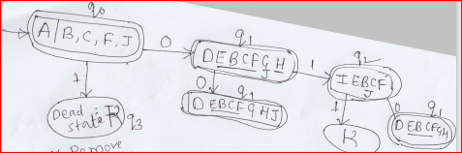
Step2 : Find ε-Closure with NFA-ε

Slide 9
Step3 : State Transition Table(δ)
Q Σ | 0 | 1
q0 | q1 | q3
q1 | q1 | q2
q2 | q1 | q3
q3 | q3 | q3

Slide 10
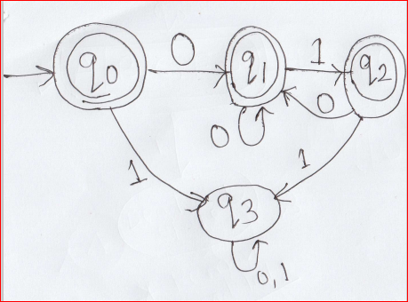
Step4 : DFA
Transition Graph
DFA tuple
Q={q0,q1,q2,q3}
Σ={ 0,1}
Initial State={q0}
Final State={q0,q1,q2}
δ= given above.

Slide 11
Convert RE to DFA
Regular Expression: r=(1.(00)*.1+0.1*.0)*
Step1 : Convert RE to NFA-ε
Step2 : Find ε-Closure with NFA-ε
Step3 : State Transition Table.
Step4 : Minimized DFA.

Slide 12
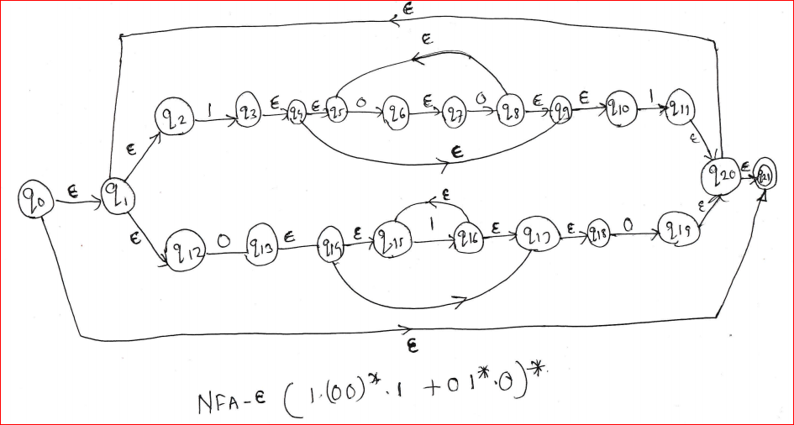
Step1 : Convert RE to NFA-ε

Slide 13
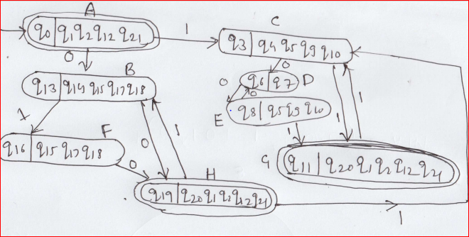
Step2 : Find ε-Closure with NFA-ε

Slide 14
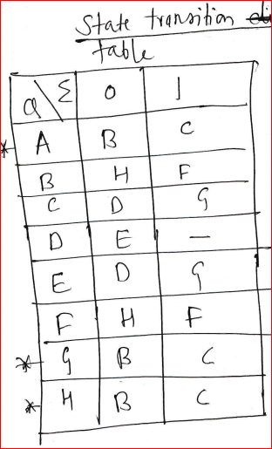
Step3 : State Transition Table.

Slide 15
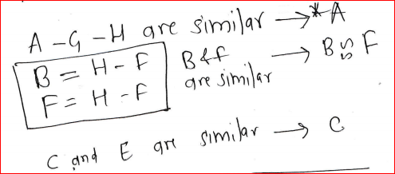
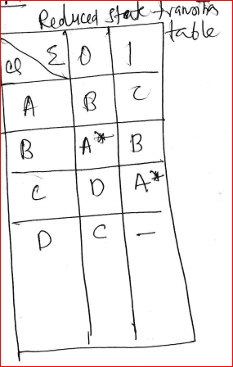
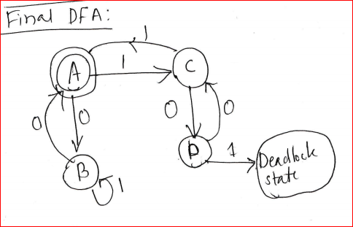
Minimized DFA

Slide 16
THANKS..
ANY QYERY???

